Slide 1
The Systems Development Life Cycle (SDLC)

Slide 2
Software Development
Systems Analysis
Activities to understand a need and to specify what an Information System should accomplish to address the need
→ What
Systems Design
Activities to define and describe in detail the system that solves the need
→ How

Slide 3
The Systems Development Life Cycle (SDLC)
Identify the problem or need and obtain approval
Plan and monitor the project
Discover and understand the details of the problem or need
Design the system components that solve the problem
Build, test, and integrate system components
Complete system tests and deploy the solution

Slide 4
System Development Process
An approach or methodology used to develop an information system
Unified process (UP)
Extreme Programming (XP)
Scrum
Most methodologies now use Agile and an iterative approach

Slide 5
Agile & Iterative Development
Agile
A development approach that emphasizes flexibility to handle failure & new requirements as they're discovered
Fast, responsive to change
Team members require multiple skills
Iterative Development
An approach which divides the project into mini-projects, each delivering a working portion of the final solution
Complete part of the system, test
Integrate, refine, add another part, test
Integrate, refine, add another part, test…

Slide 6
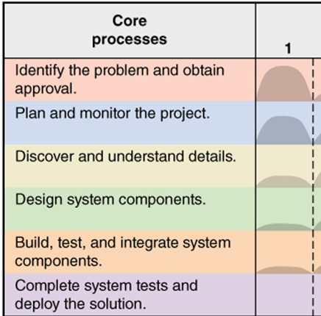

Evolution of the project - each iteration is a mini-project - all use the six core processes, but their emphasis evolves
The first iteration (Initialization)
Is heavy on:
Understanding the need
Identifying requirements
Delivering a high-level project vision
Identifying the major components
Can deliver a partial solution:
Proof-of-concept for critical components
Without which the project is impractical

Slide 7
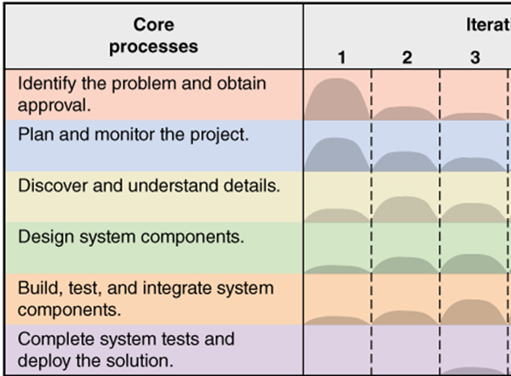
Evolution of the project - each iteration is a mini-project - all use the six core processes, but their emphasis evolves
Subsequent Iterations (Construction)
Review and revise the project vision
New requirements can be added
Possibly modifying existing components
Discovering detailed requirements
Only for the component(s) of this iteration
More focused on producing a solution
For part of the overall project

Slide 8
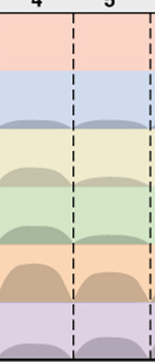
Evolution of the project - each iteration is a mini-project - all use the six core processes, but their emphasis evolves
Construction iterations continue
Project vision firms up
New requirements can still be discovered
Still detailing & developing new component(s)
Focus shifting to integration & testing
Deployment is possible at any time

Slide 9
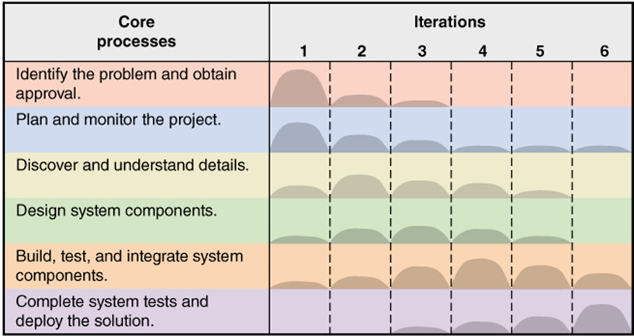
Evolution of the project - each iteration is a mini-project - all use the six core processes, but their emphasis evolves
The last iteration (Transition)
Integration & acceptance testing
Deployment planning
Deploy & support the solution

Slide 10
Deployment can happen at any time
Each iteration should deliver a working solution
Which is tested by itself (unit testing, acceptance testing)
…then combined with prior deliverables (integration testing)
An iteration may be deployable (stand-alone, marketable)
Providing business value before the whole project is complete
Consider D2L:
Online notes, homework upload, quizzes, grades …
"online notes" alone would be a VERY marketable solution
→ new development stops → test and deploy
Start a new project with the remaining requirements

Slide 11
RMO – Sample Project in 6 days
To be integrated into a larger supply-chain management system

Slide 12
Ridgeline Mountain Outfitters (RMO)
Large Retail Company
Outdoor and sporting clothing and accessories
Skiing, mountain biking, water sports
Hiking, camping, mountain climbing
Rocky Mountain and Western States
Started mail order and phone order
Added retail stores
Added extensive E-business component

Slide 13

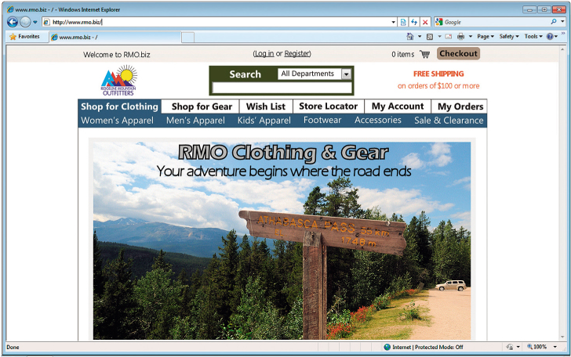
RMO Marketing

Slide 14
RMO Tradeshow System
Problem
Purchasing agents attend apparel and fabric trade shows around the world to order new products from suppliers
Need
Information system (app) to record and track information about suppliers and new products while at tradeshows
Tradeshow Project is proposed:
Supplier information subsystem
Product information subsystem

Slide 15
Initial Activities – pre-project
Identify the problem and document the objective of the system (core process 1)
Preliminary investigation
System Vision Document
Obtain approval to commence the project (core process 1)
Meet with key stakeholders, including executive management
Decision reached, approve plan and budget

Slide 16
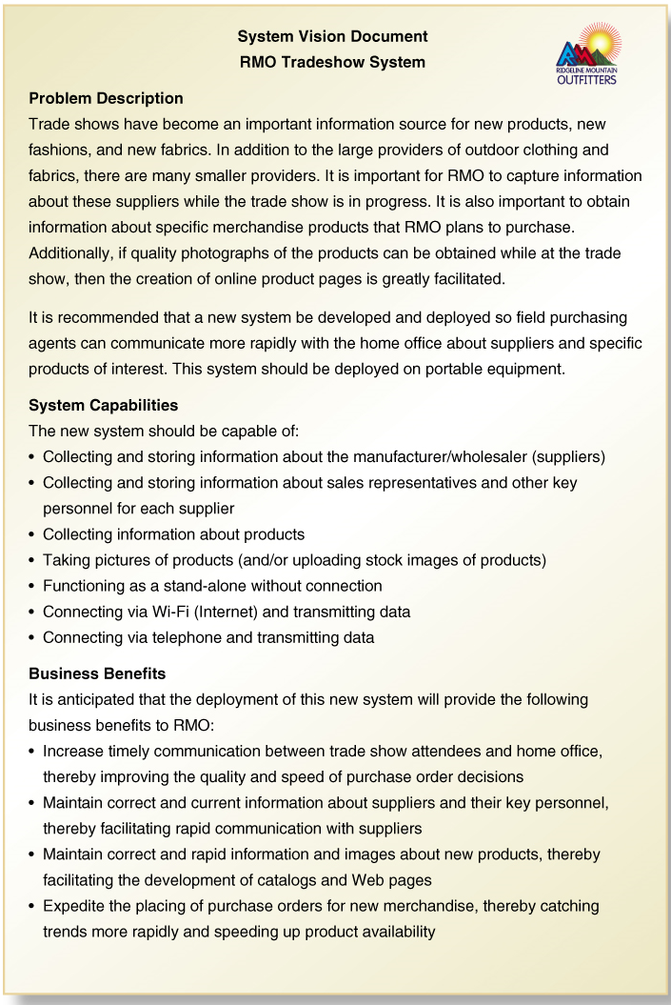
Problem description
System capabilities
Business benefits

Slide 17
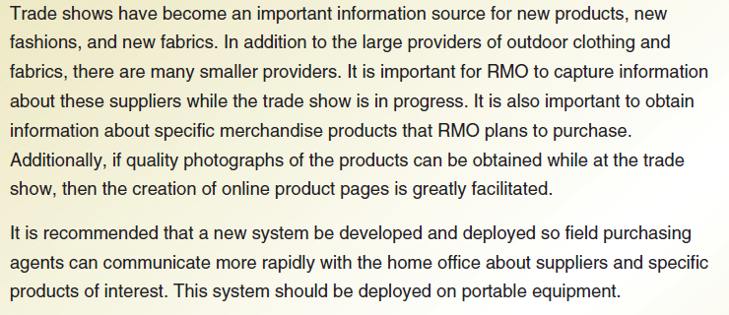
System Vision Document Problem Description

Slide 18
System Vision Document System Capabilities

Slide 19
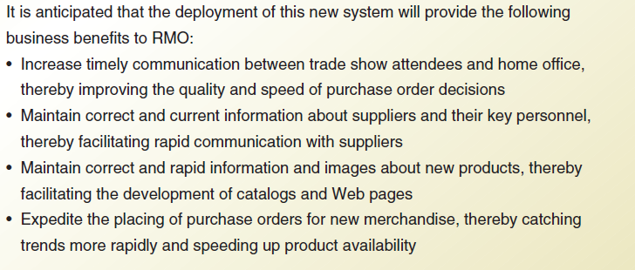
System Vision Document Business Benefits

Slide 20
Day 1 Activities
Core Process 2: Plan the Project
Determine the major components (functional areas) that are needed
Supplier information subsystem
Product information subsystem
Define the iterations and assign each function to an iteration
Decide to do Supplier subsystem first
Plan one iteration as it is small and straight-forward
Determine team members and responsibilities

Slide 21
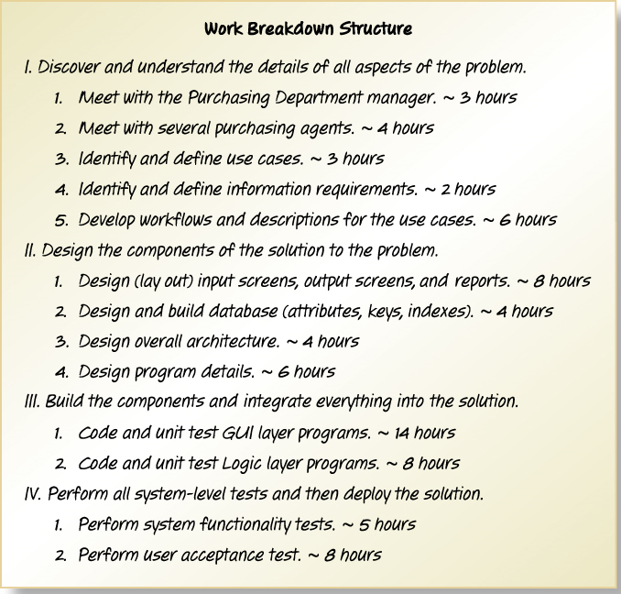
Work Breakdown Structure for Iteration
Describes the work
Covers Core Processes 3, 4, 5, and 6

Slide 22
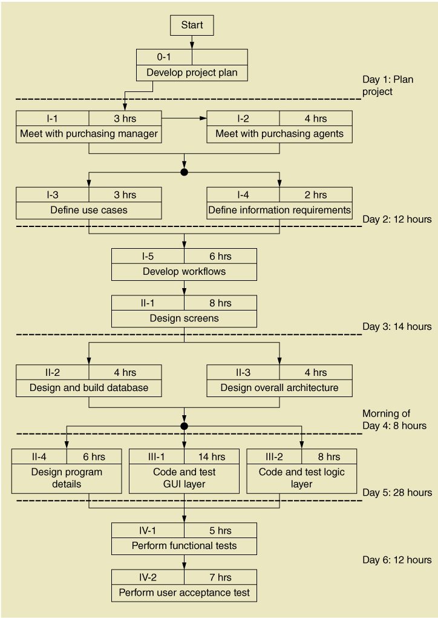
Work Sequence Draft for Iteration
Elaborates the Work Breakdown Structure

Slide 23
Day 2 Activities
Core Process 3: Discover and Understand Details
Do preliminary fact-finding to understand requirements
Develop a preliminary list of use cases and a use case diagram
Develop a preliminary list of classes and a class diagram

Slide 24
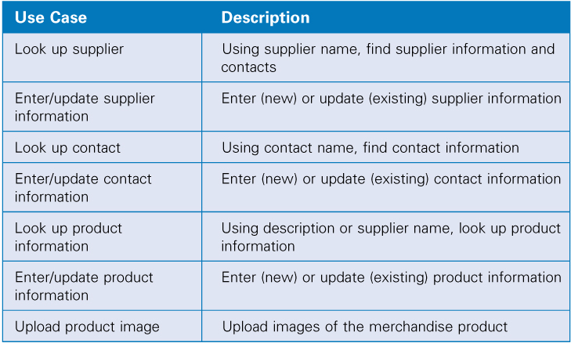
Identify Use Cases Both subsystems

Slide 25
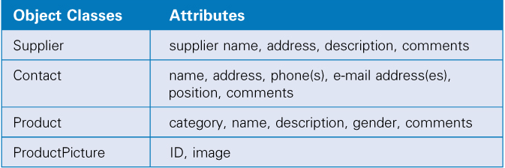
Identify Object Classes Both subsystems

Slide 26
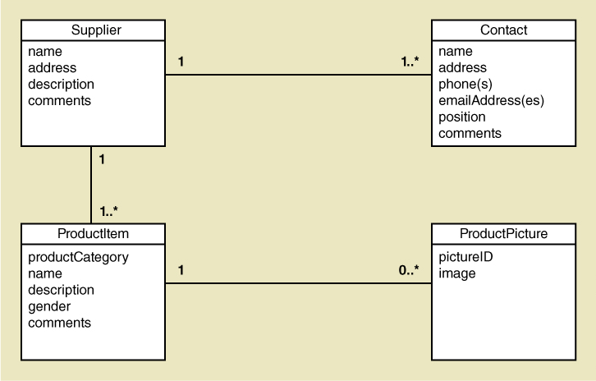
Preliminary Class Diagram Both subsystems
Domain Class Model
Notice:
No keys
No datatypes
Intent:
Identify things of interest
& their properties
Discussion points for approval:
Don't get users hung up on technical issues

Slide 27
Day 3 Activities
Core Process 3: Discover and Understand Details
Do in-depth fact-finding to understand requirements
Understand and document the detailed workflow of each use case

Slide 28
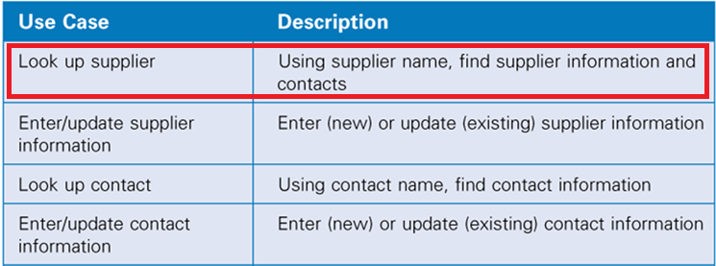
Supplier Information Subsystem Use Cases

Slide 29
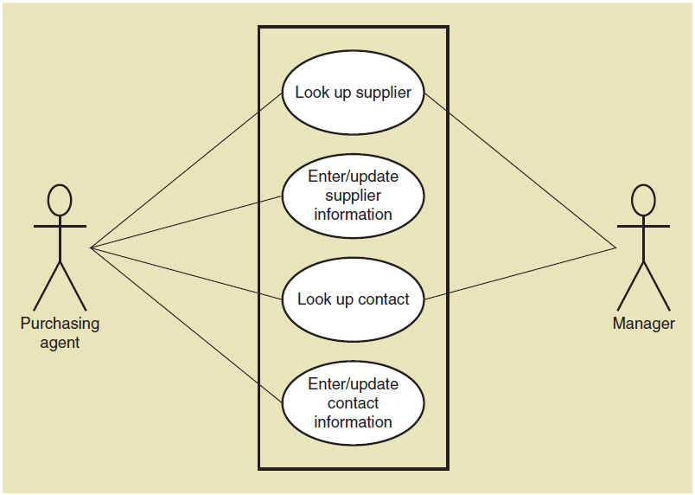
Supplier information subsystem Use Case Diagram
Two different Actors
With different interests in the system

Slide 30
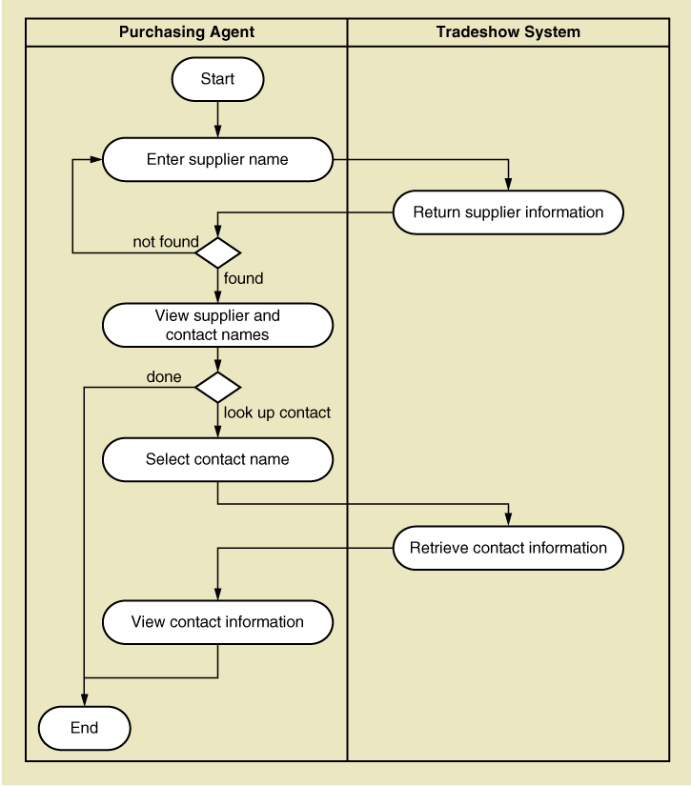
Activity Diagram (Workflow)
Use Case:
Look up supplier
Doesn't include add & update
Not all actors require these

Slide 31
Day 4 Activities
Core Process 4: Design System Components
Define the user experience with screens and report sketches (prototyping)
Core Process 4: Design System Components
Design the database (schema)
Design the system’s high level structure
Browser, Windows, or Smart phone
Architectural configuration (components)
Design class diagram
Subsystem architectural design

Slide 32
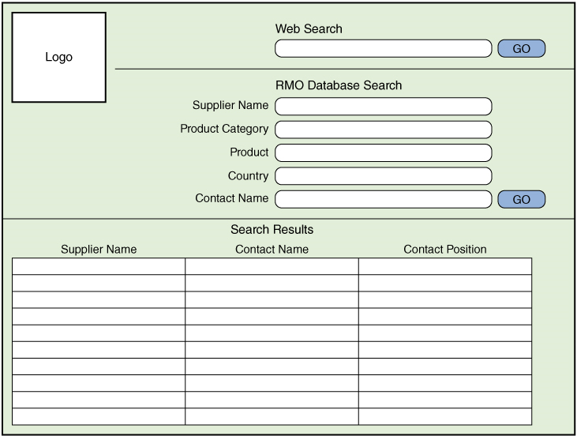
Draft Screen Layout (prototype) Look up supplier use case

Slide 33
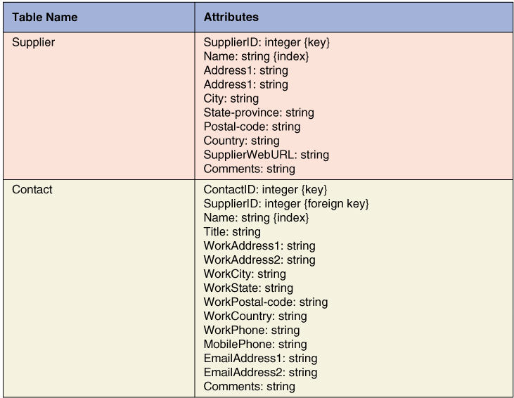
Database Schema
Huh … You won't make this mistake, RIGHT?

Slide 34
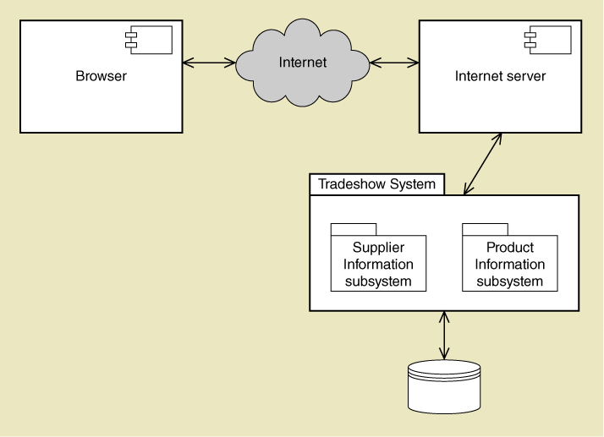
Architectural Configuration Diagram

Slide 35
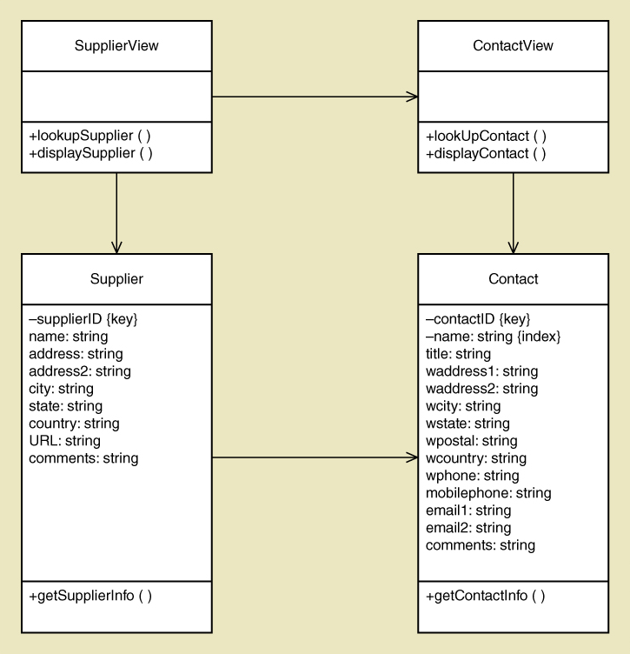
Preliminary Design Class Diagram - View Layer Classes - Domain Layer Classes

Slide 36
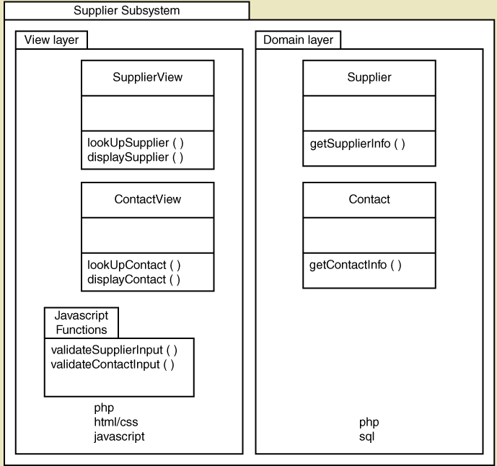
Subsystem Architectural Design Diagram

Slide 37
Notes on Managing the Project
Lots of design diagrams were just shown
Usually only in a complex activity with multiple levels
Diagrams can build on or complements others
Changes cause a cascade update
Not everything needs to be diagrammed
Especially for a small project → pick and choose.
Programming is also done concurrently
You don’t design everything then code
You do some design, some coding, some design, some coding

Slide 38
Day 5 Activities
Core Process 4: Design System Components
Continue with design details
Proceed use case by use case
Core Process 5: Build, Test, and Integrate System Components
Continue programming (build)
Build use case by use case
Perform unit and integration tests

Slide 39
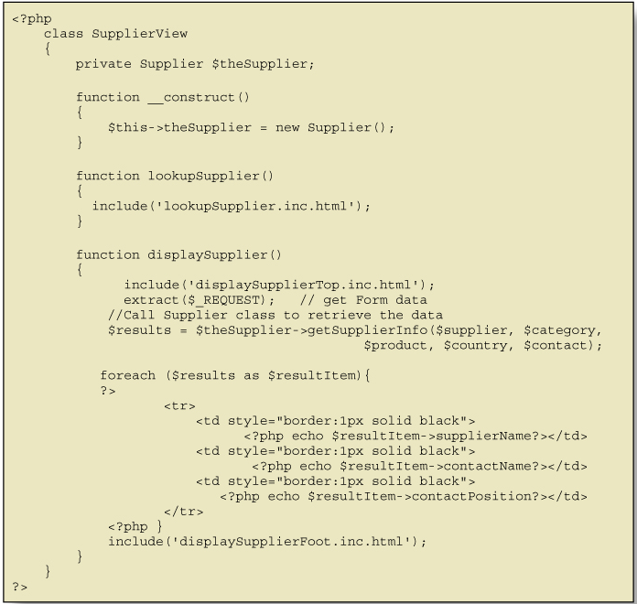
Code Example for One Component

Slide 40
Day 6 Activities
Core Process 6: Complete System Testing and Deploy the System
Perform system functional testing
Perform user acceptance testing
Possibly deploy part of system

Slide 41
Workflow of Testing Tasks

Slide 42
First Iteration Recap
This was a 6-day iteration of a small project
Most iterations are longer (2 to 4 weeks)
This project might be 2 iterations
Most projects have many more iterations
End users need to be involved
…particularly in days 1, 2, 3 and 6.
Days 4 and 5 involve designing and programming concurrently.

Slide 43
Summary – Terms to know & use
Computer application
Information system
Project
Systems analysis
System design
System development lifecycle (SDLC)
Information system development process (methodology)
Agile development
Iterative development
System vision document
Work breakdown structure
Work sequence draft
Use cases
Use case diagram
Object classes (domain classes)
Class diagram
Design class diagram
High level structural design (architectural design)
Database schema
Screen layout

